Slide 1
Generating noisy speech data from clean data in the frequency domain using Deep Learning Methods
Week – 11
Name: Shashank Shirol
University: Manipal Institute of Technology
Duration of the presentation: ~10 mins.

Slide 2
Tasks to be completed:
To write transforms for CutGAN to preserve dimensions of the input clean spectrograms.
To apply a ffmpeg codec to audios before generation through CutGAN. To see if the results improve.
To modify SinGAN to use vertical cross-sections as receptive field, instead of 11x11.
This task would require a substantial modification to the architecture of SinGAN.
This changes how the generators and the discriminators are set up.
To write a number of helper functions to facilitate such a modification.

Slide 3
Modify CutGAN to preserve dims of clean spectrogram (I):
Wrote transforms to modify the dimensions of Domain B spectrograms to match the dimensions of Domain A spectrograms.
This resulted in two things:
Increase in training time, because of the larger size of the spectrograms (previously fixed at 256px)
Inconsistency in learning the mapping caused due to smaller domain B images stretched to match domain A dimensions
This ultimately worsened the results and the LSD of the outputs took a hit
Results:
LSD (when spec. had a cap of 256px): 6.81
LSD (when spec. were resized): 13.99

Slide 4
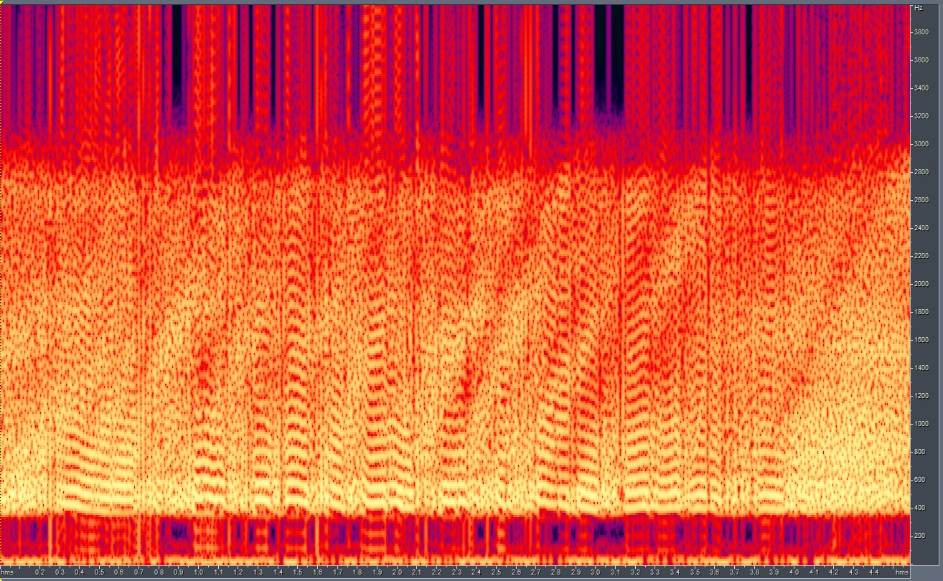
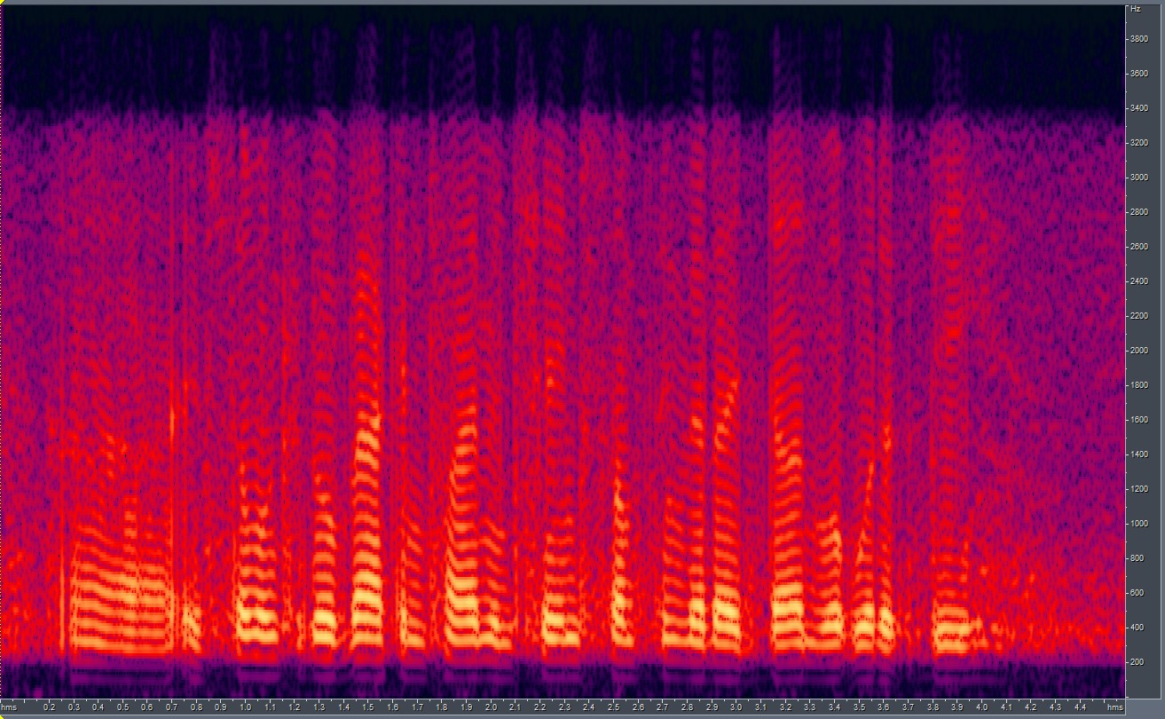
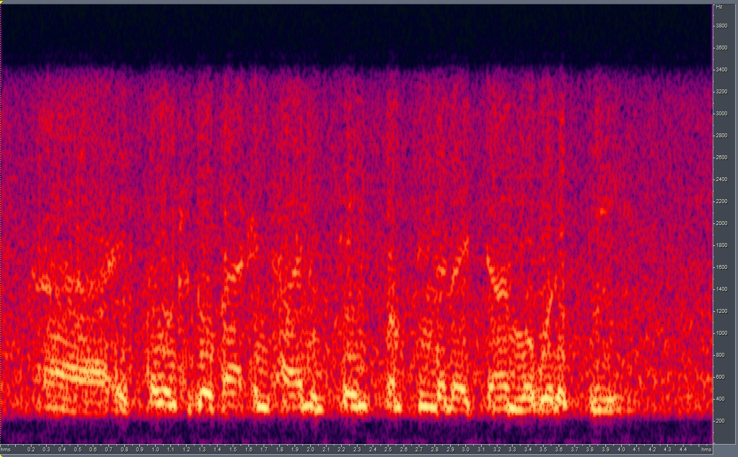

Modify CutGAN to preserve dims of clean spectrogram (II):
when resized
capped at 256px
GT

Slide 5
Apply a codec before generation using CUT (I):
Wrote a helper function that is activated by using a command-line argument during the generation process.
The helper function uses a subprocess to run ffmpeg internally, and encodes the audio files with g726 codec with a specified bitrate of 16k on the test files before passing them for generation.
Why the specific codec with the stated bitrate? It produced results that most resembled the target output – RATS CORPUS.
The results obtained are poor, with generation on encoded audio files taking a hit:
LSD w g726 applied before generation: 9.67
LSD w/o g726 applied before generation: 6.15

Slide 6
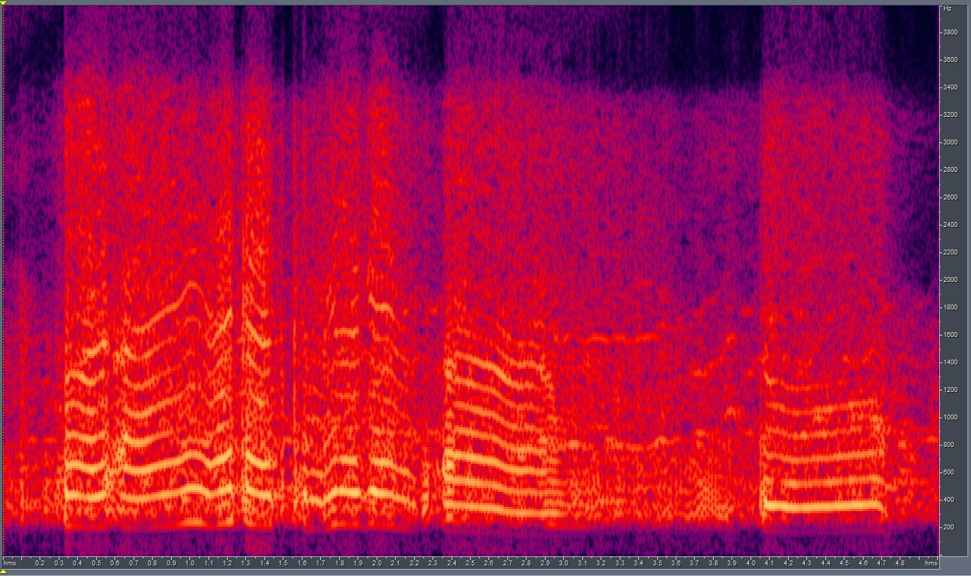
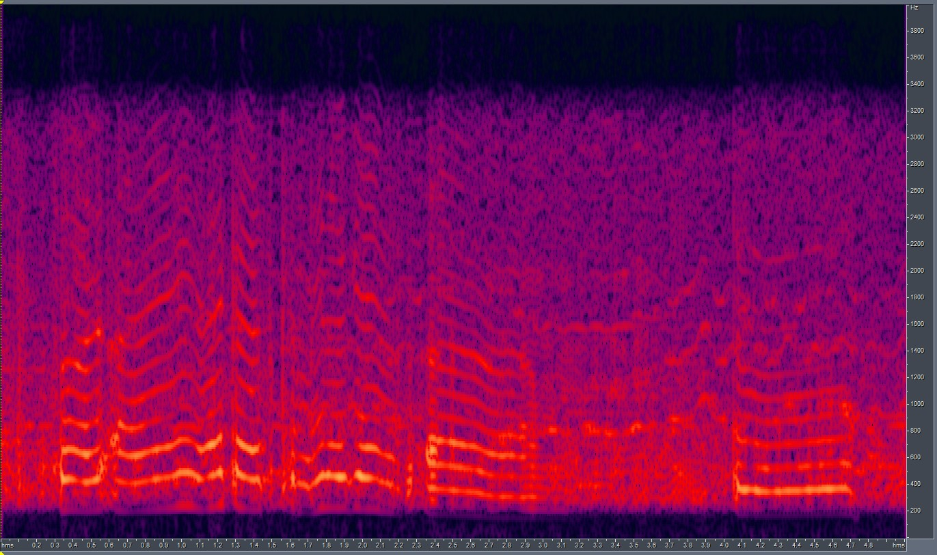
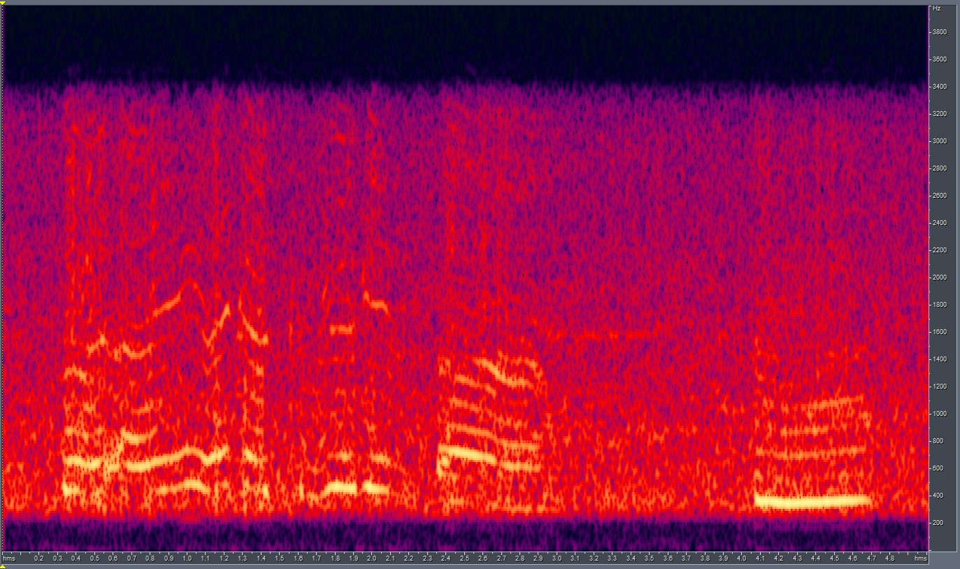
Apply a codec before generation using CUT (II):
w codec
w/o codec
GT

Slide 7
Modify SinGAN to change the receptive field from 11x11 squares to vertical cross-sections
Problems to tackle:
Non-square kernels for convolution: For enabling us to make use of vertical cross-sections as receptive fields, we alter the kernel sizes to use rectangular kernels
This brings the problem of dimensionality in down-sampled images: The rectangular kernels cannot move across down-sampled images equally – leading to different padding requirements for each side.
Since receptive field changes with each scale of training, we have to change the kernel size at each scale – leading to mismatch on the weights learned at each scale because weights learned have the dims(in_channels, out_channels, kernel_size)
Since SinGAN uses a multi-scale architecture that uses images from previous scale (different padding) + noise generated at current scale (different padding) it becomes imperative to store the various padding dimensions to use during the paint2image process.

Slide 8
Modifying the kernel sizes:
The receptive field in the SinGAN implementation follows: receptive_field_ = ker_size + ((ker_size - 1)*(num_layer - 1))*stride; num_layers = no. of convolutional layers (5 here)
So, for a kernel size of 3x3 (default) we get a receptive field of 11x11
Hence, to get a receptive field(s) of (input_h x {3,4,5}) we use the above equation to find the appropriate kernel sizes for each scale
Many times, the dims of the input image may not give an whole number kernel size, in those cases we add row(s) (or column(s)) of zeros of appropriate dimensions to get a whole number kernel.
E.g. An image of 25 x 72 that should have a receptive field of input_h x 3 (say) would give a kernel size of 5.8 x 1.2 which is not possible, so we append 1 row of zeros and 3 columns of zeros to make the image 26 x 75 which gives a kernel size of 6x2

Slide 9
Getting the padding right:
The padding required for a square kernel kernel_size and num_layer convolutional layers, is given by: padd = int(((ker_size - 1) * num_layer) / 2)
So, for 3 x 3 kernel size and 5 convolutional layers we get a padd_size of 5
We model our formula for calculating the required padd_dims using the above formula.
Since we would have non-uniform kernel sizes (dependent on image size at current scale), we will have to take care of the case when we get even ker_size.
We tackle the above problem by increasing the padd_dim on one of the sides by 1.
E.g. For ker_size (6 x 2), we have padd_up = padd_down = (6 - 1)*5/2 = 12.5 → ✘ So, we increase either padd_up or padd_down by 1, resulting in vertical padding of 12 and 13.

Slide 10
Utilizing State information from previous scale:
As we know, SinGAN trains it architecture scale-by-scale, meaning it trains a scale, freezes it and moves on to the next scale.
SinGAN saves the learned weights after each scale is trained and loads these weights when training the new scale (because it uses the output of the generator from previous scales to train subsequent scales)
This arises the problem of weight dim mis-match, i.e. the weights trained in the previous scale don’t have the right dimensions to be loaded; owing to changing kernel sizes and padding settings.
One solution is we match the difference by weights initialized from a normal distribution.
Why normal distribution? Because SinGAN uses it to initialize the weights for the first scale, where the generator is trained purely by noise.

Slide 11
Final touches and modifying the paint2image module:
Apart from the three critical problems tackled in the precious slides, the main training module also required some additional modifications to correctly use the functions that were modified above.
The paint2image module needs to load the right networks for each scale and the appropriate weights and padding dimensions to have the generators generate outputs.
Therefore it becomes imperative to save the padd_dimensions for each scale in a way they can be loaded later.
We save the dimensions as serialized objects on disk.
The PyTorch function that takes care of this, torch.save(obj) uses Python’s pickle utility for serialization.

Slide 12
End.

